Slide 1


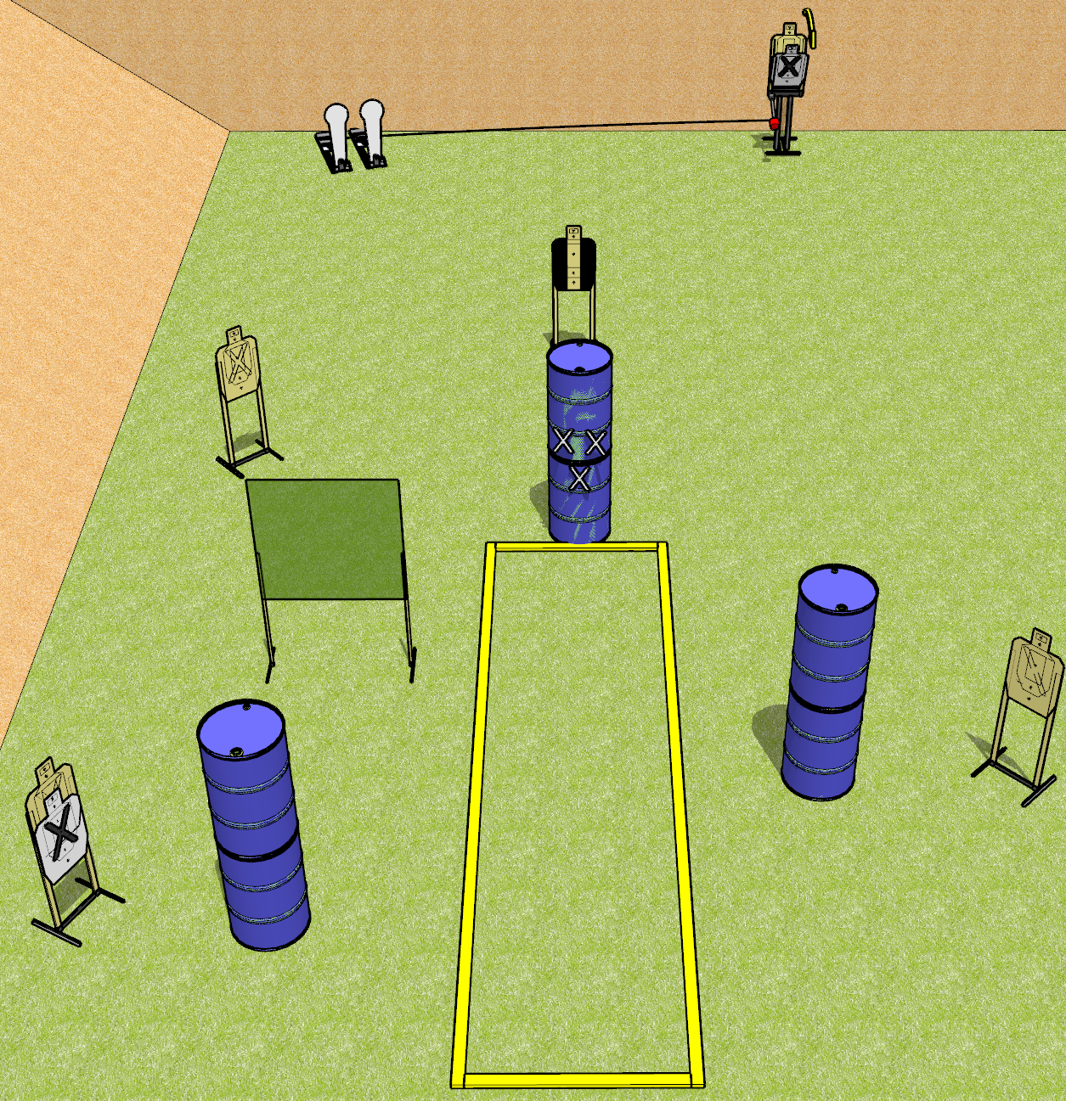
 | Dothan Gun Club – USPSA Match Back it Up Course Designer : Drew Coleman
START POSITION : Standing behind barrel with marks on it, fingers touching marks.
GUN READY CONDITION : Pistol loaded and holstered. PCC loaded, held with both hands, shouldered, safety on, muzzle touching a mark. |  | SCORING: Comstock, 12 rounds TARGETS: 5 paper, 2 Steel SCORED HITS: Best 2 on paper, steel until down START-STOP: Audible, last shot RULES:
STAGE PROCEDURE: Engage targets as they become available from within the fault lines.

Slide 2
Back it Up
Written Stage Briefing
Back it Up is a 12 round, 60 point, Comstock short course. There are five USPSA targets and two Colt poppers. The best two hits on paper will score, and steel must fall to score. The start signal is audible.
Either popper will activate the Max Trap. The Max Trap is not a disappearing target. Please check the activators before walkthrough and set them the same way every time.
Handgun start position is standing behind barrel with marks on it with fingers touching upper set of marks. Handgun is loaded and holstered.
PCC start position is standing behind barrel with marks on it, muzzle touching any mark. Loaded carbine is held with both hands, safety on, shouldered.
On start signal, engage targets as they become available from within the shooting area.

